Slide 1
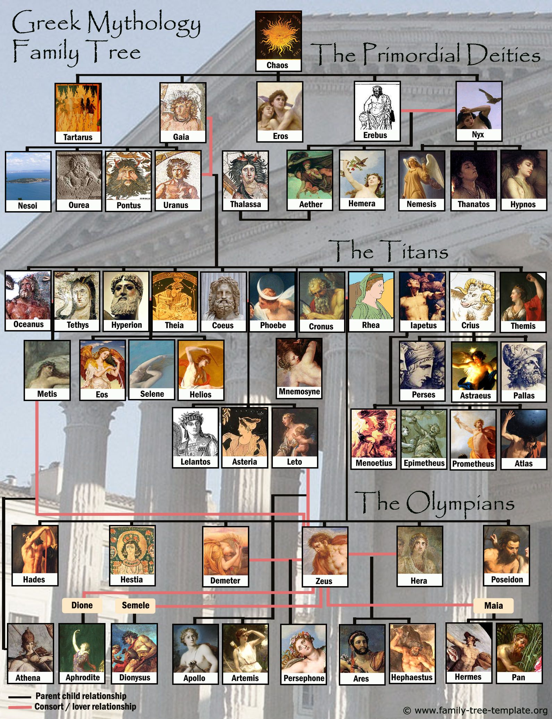
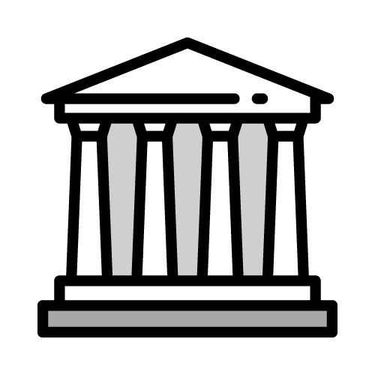
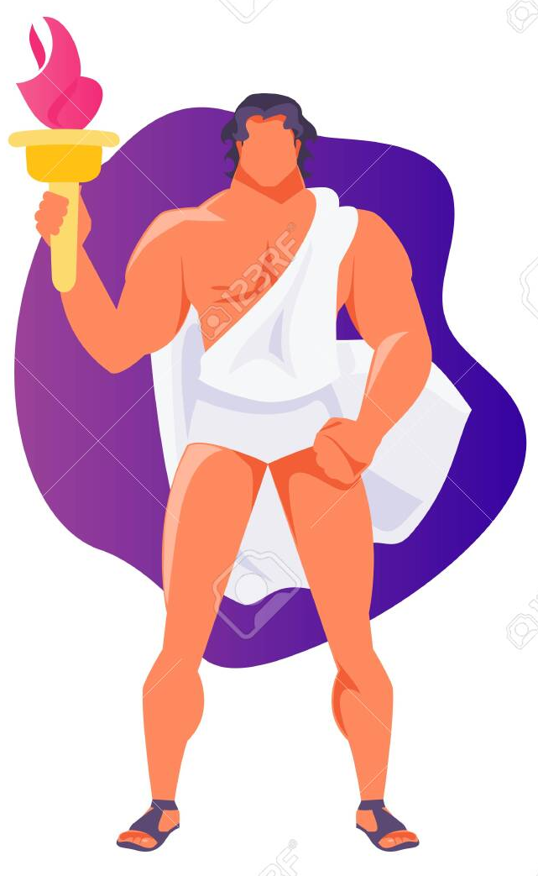



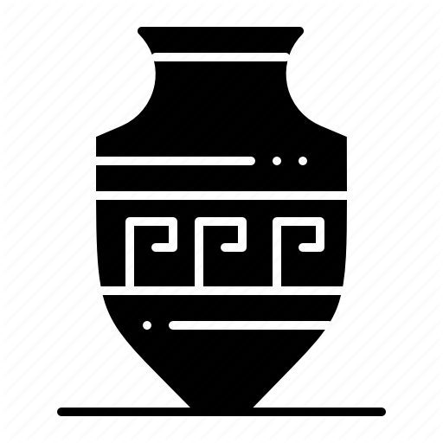
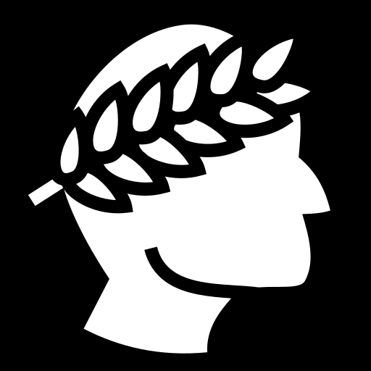

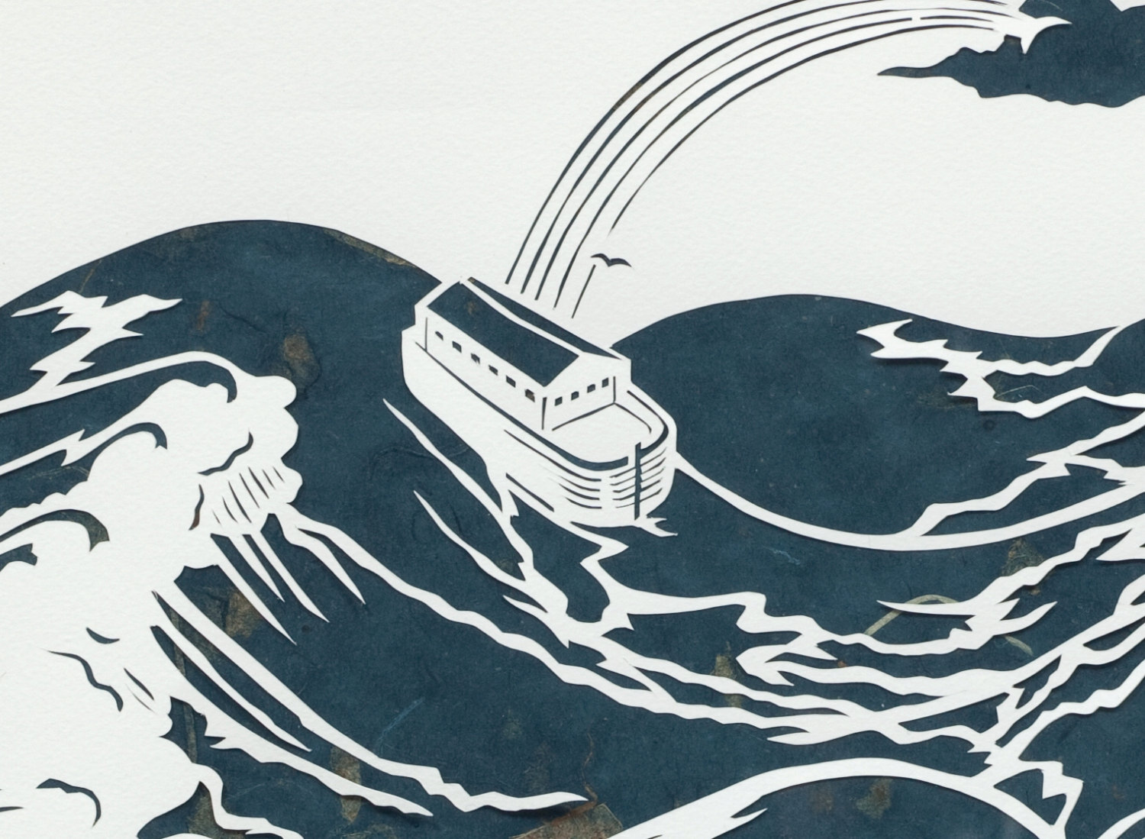
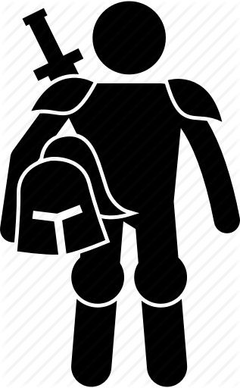
Greek Mythology
Culture of Ancient Greek and Roman
Zeus
Prometheus
Golden Age
Silver Age
Bronze Age
Flood myth
-800
-146
476
Antikens Grekland
Romarriket
Heroic Age

Slide 2

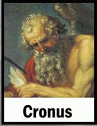
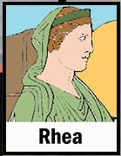

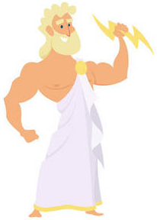
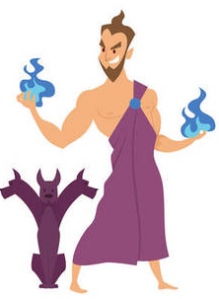
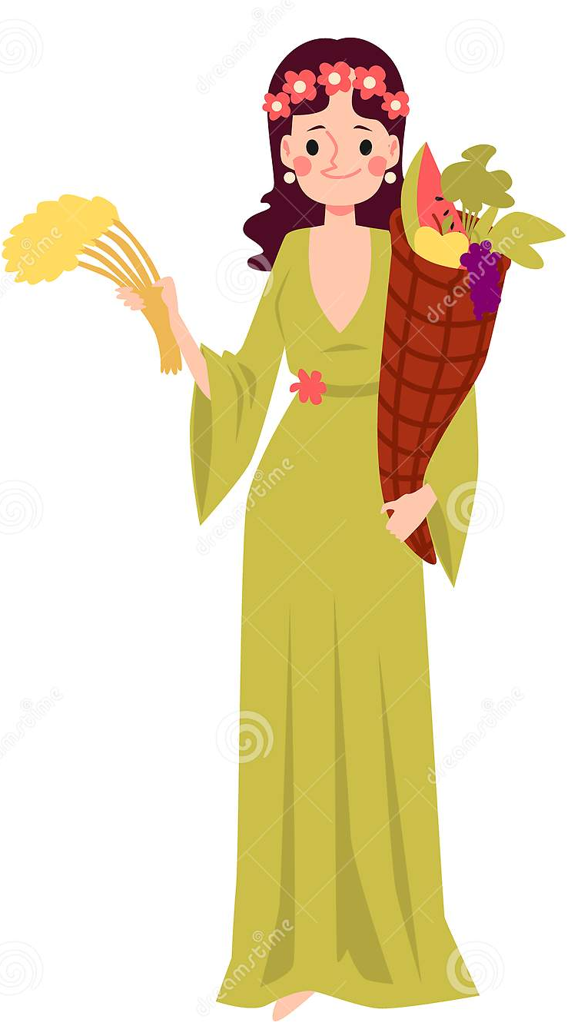
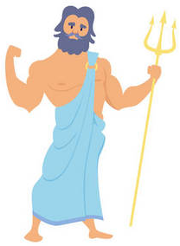
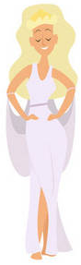

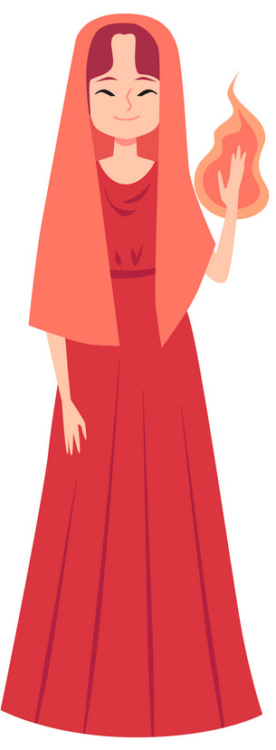
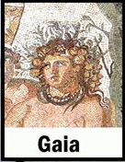

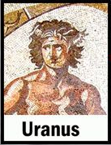
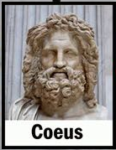

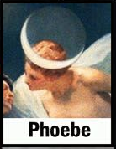
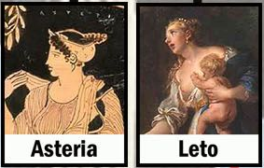
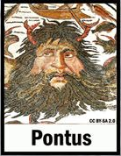


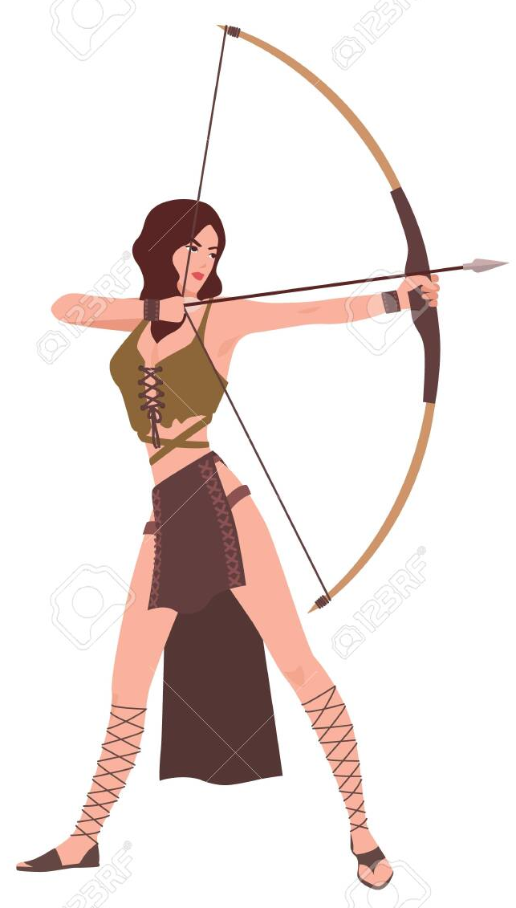

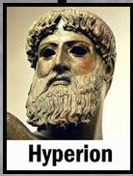
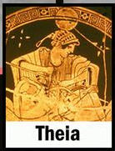
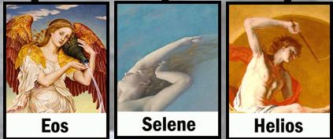
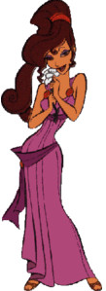
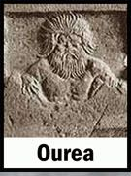
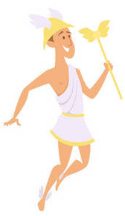
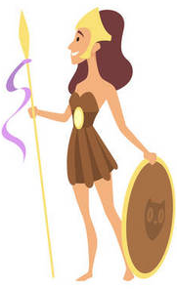
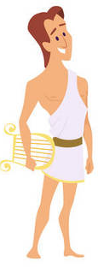
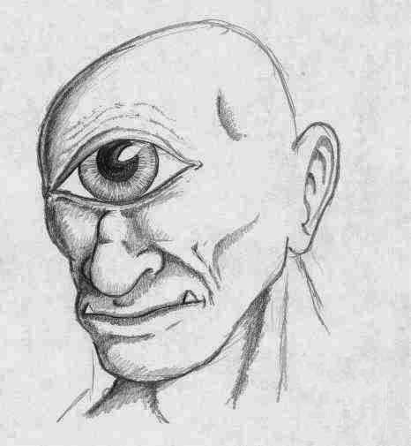
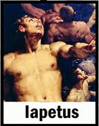
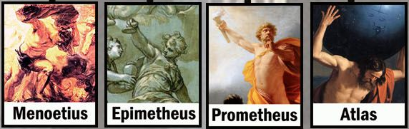
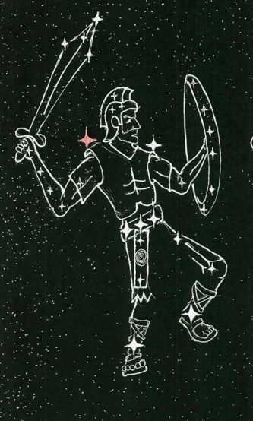
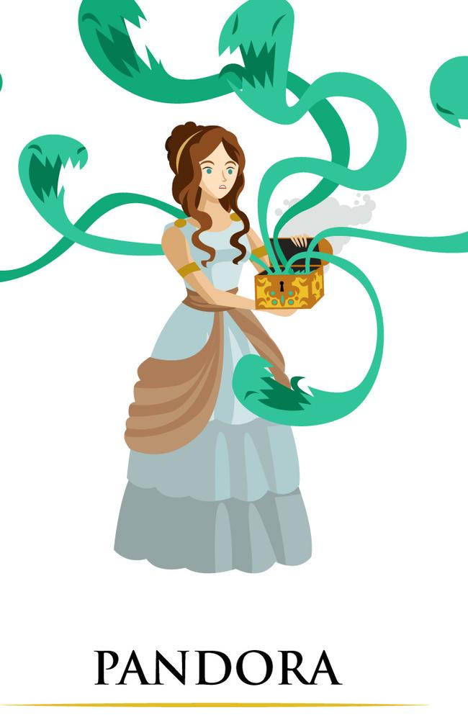
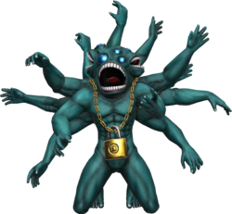
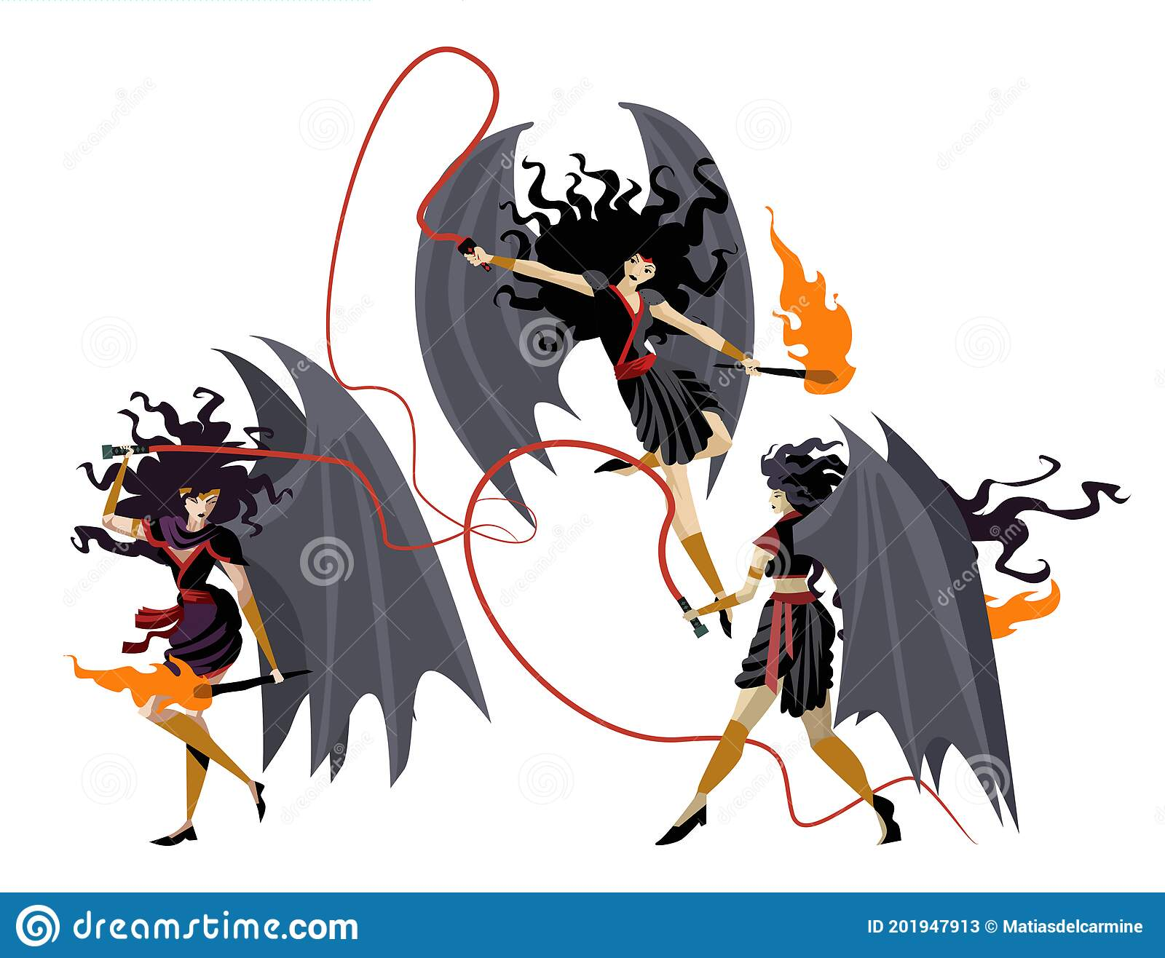
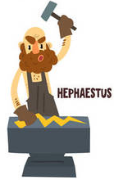
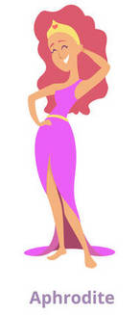
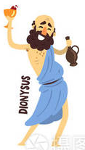
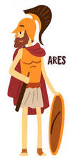
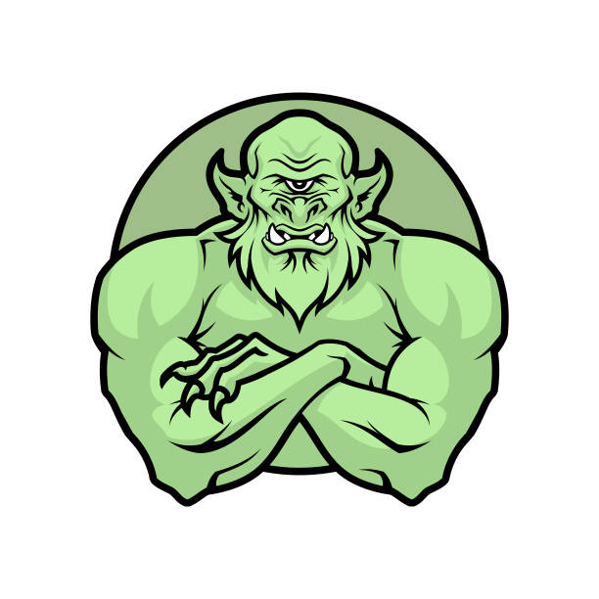

Chaos
Greek primordial deities
The Titans
The Twelve Olympians
Hestia
Hades
Demeter
Poseidon
Hera
Zeus
Cerberus
Persephone
Hermes
Athena
Apollo
Artemis
Cyclopes (Brontes, Steropes, and Argus)
Orion & Sirius
Pandora
Hecatoncheires (Cottus, Briareos, and Gyes)
Giants/Gigantes
Aphrodite
Hephaestus
Dionysus
Ares
Erinyes / furies (Tisiphone(murder), Megaera(jealous); Alecto(constant anger))
Eros/Cupido

Slide 3
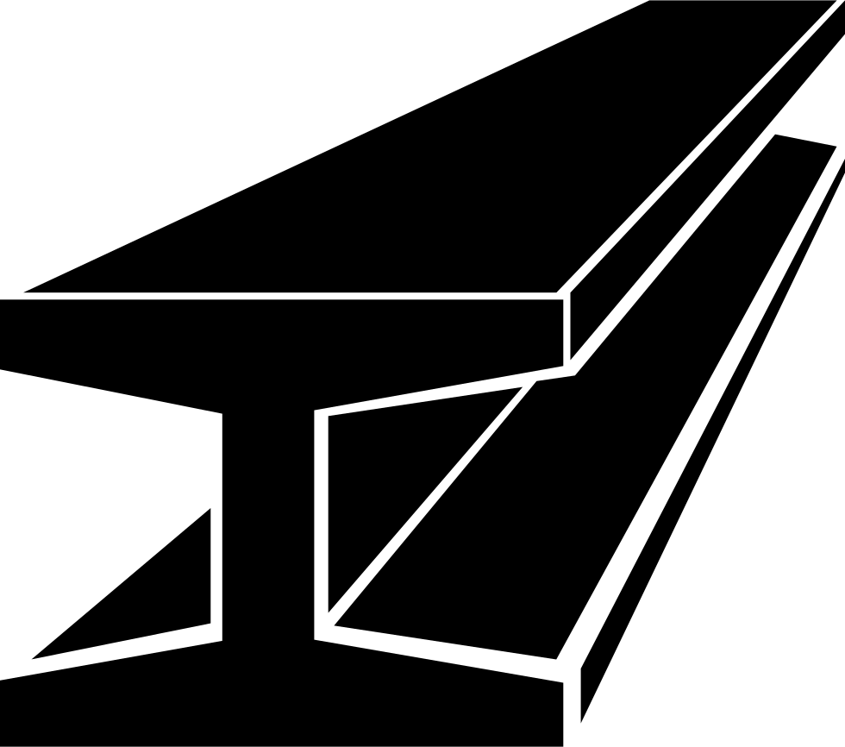
Hesiod's Five Ages
The Greek poet Hesiod (between 750 and 650 BC), in his poem Works and Days (lines 109–201). His list is:
Zeus
Prometheus
Golden Age – The Golden Age is the only age that falls within the rule of Cronus. Created by the immortals who live on Olympus, these humans were said to live among the gods and freely mingled with them. Peace and harmony prevailed during this age. Humans did not have to work to feed themselves, for the earth provided food in abundance. They lived to very old age but with a youthful appearance and eventually died peacefully. Their spirits live on as "guardians". Plato in Cratylus (397e) recounts the golden race of men who came first. He clarifies that Hesiod did not mean men literally made of gold, but good and noble. He describes these men as daemons upon the earth. Since δαίμονες (daimones) is derived from δαήμονες (daēmones, meaning knowing or wise), they are beneficent, preventing ills, and guardians of mortals.
Silver Age – The Silver Age and every age that follows fall within the rule of Cronus's successor and son, Zeus. Men in the Silver age lived for one hundred years under the dominion of their mothers. They lived only a short time as grown adults and spent that time in strife with one another. During this Age men refused to worship the gods and Zeus destroyed them for their impiety. After death, humans of this age became "blessed spirits" of the underworld.
Bronze Age – Men of the Bronze Age were hardened and tough, as war was their purpose and passion. Zeus created these humans out of the ash tree. Their armor was forged of bronze, as were their homes, and tools. The men of this Age were undone by their own violent ways and left no named spirits; instead, they dwell in the "dank house of Hades". This Age came to an end with the flood of Deucalion.
Heroic Age – The Heroic Age is the one age that does not correspond with any metal. It is also the only age that improves upon the age it follows. It was the heroes of this Age who fought at Thebes and Troy. This race of humans died and went to Elysium.
Iron Age – Hesiod finds himself in the Iron Age. During this age, humans live an existence of toil and misery. Children dishonor their parents, brother fights with brother and the social contract between guest and host (xenia) is forgotten. During this age, might makes right, and bad men use lies to be thought good. At the height of this age, humans no longer feel shame or indignation at wrongdoing; babies will be born with gray hair and the gods will have completely forsaken humanity: "there will be no help against evil."

Slide 4
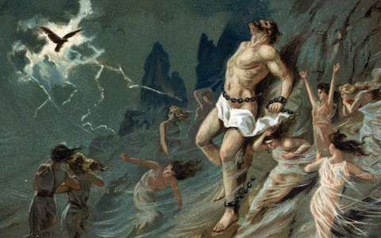

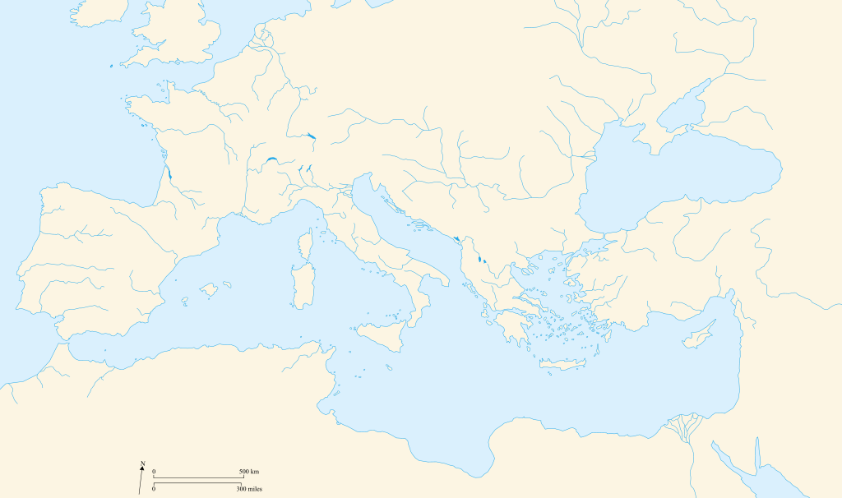
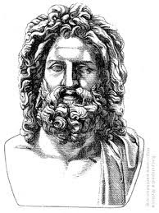
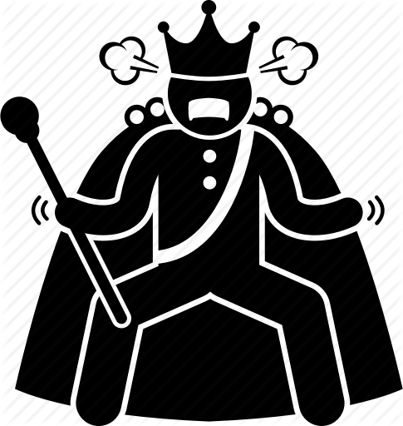
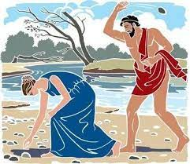

Fire theft
human
Prometheus
Zeus
Flood myth
Bronze Age
Arcadia
Epimetheus
Heroic Age
Hephaestus
Lycaon
human
Lykánthropos + ánthrōpos
lycanthropy
Pyrrha
Deucalion

Slide 5
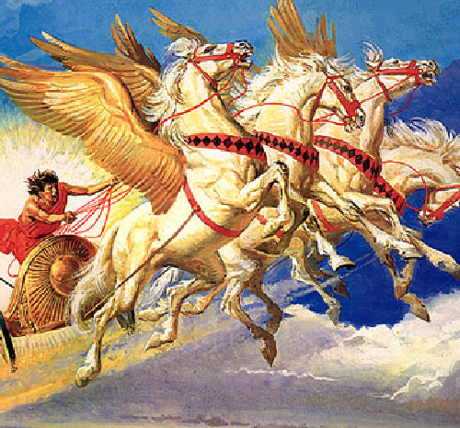
Phaethon
Phaethon

Slide 6

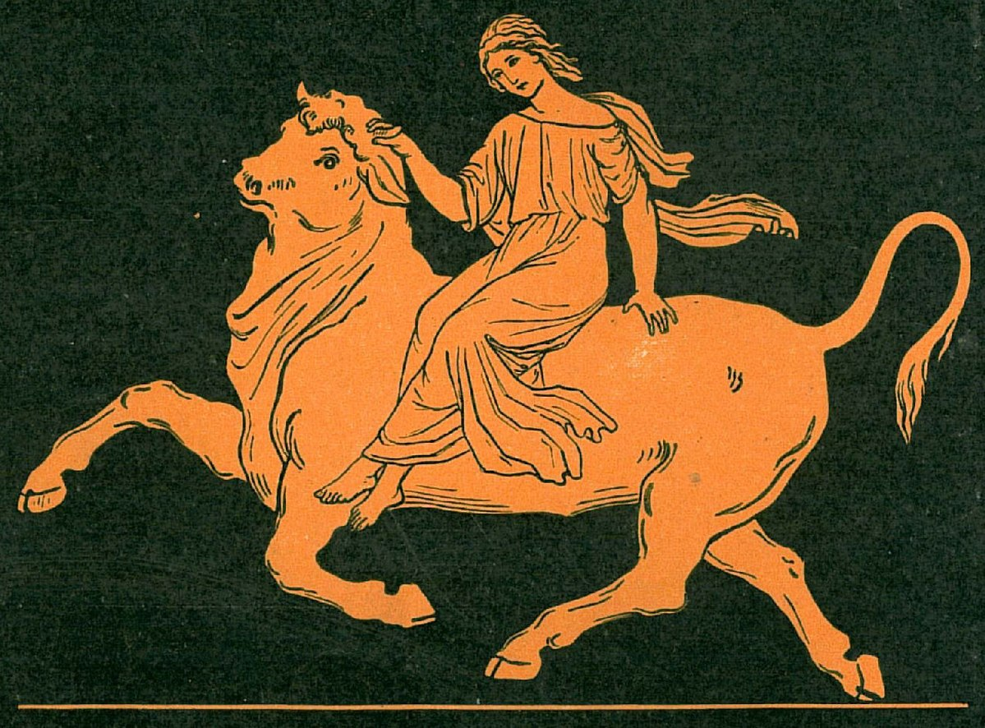











Zeus
Io
Libya
Agenor
Theban kings in Greek mythology
Europa
Zeus
Harmonia
Cadimus
Minos
Polydorus
Semele
Zeus
Autonoe
Acrisius
Minotaur
Labdacus
Dioysus
Actaeon
Danaë
Zeus
Thebes
Laius
Jocasta
Perseus
Athens
Argos
Oedipus
Alcmene
Zeus
Heracles
Crete

Slide 7


Slide 8




Argive genealogy in Greek mythology
Actaeon

Slide 9







Io
Argus Panoptes
Zeus
Hera
Hermes
gadfly
Pan
Syrinx
Argos
Egypt
Argos
Io
Epaphus
Apis
Isis
Libya

Slide 10

Europa
Europa
Zeus
Crete
Phoenicia
Minos

Slide 11







Cadmus
Hephaestus
Aphrodite
Ares
Apollo
Necklace of Harmonia (The cursed necklace)
Ismenian spring's guardian water-dragon
Harmonia
Cadmus
Thebes
Zeus
Semele
Phoenicia
Dionysus

Slide 12



Actaeon
Actaeon in Greek mythology, son of the priestly herdsman Aristaeus and Autonoe in Boeotia, was a famous Theban hero. Like Achilles in a later generation, he was trained by the centaur Chiron.
He fell to the fatal wrath of Artemis, but the surviving details of his transgression vary: "the only certainty is in what Aktaion suffered, his pathos, and what Artemis did: the hunter became the hunted; he was transformed into a stag, and his raging hounds, struck with a 'wolf's frenzy' (Lyssa), tore him apart as they would a stag." This is the iconic motif by which Actaeon is recognized, both in ancient art and in Renaissance and post-Renaissance depictions.
Cadmus
Thebes
Actaeon
Athens
Pisa (Elis)
Peloponnese
Crete
Artemis
Tantalus

Slide 13






Perseus
Acrisius
Athena
Disappointed by his lack of male heirs, King Acrisius asked the oracle of Delphi if this would change. The oracle announced to him that he would never have a son, but his daughter would, and that he would be killed by his daughter's son.
Gorgons' cave
Zeus
Hesperides
Danaë
Hades' helm of darkness to hide
knapsack (kibisis)
Athena gave him a polished shield.
Zeus gave him adamantine sword (a Harpe)
Medusa
Argos
Hermes lent Perseus winged sandals to fly (The Talaria of Mercury)
Serifos
Perseus
Crete
Perseus

Slide 14




Perseus
Perseus turns Phineus and his followers to stone (Luca Giordano, 17th century)
Perseus
Andromeda
On the way back to Seriphos, Perseus stopped in the kingdom of Aethiopia. This mythical Ethiopia was ruled by King Cepheus and Queen Cassiopeia. Cassiopeia, having boasted that her daughter Andromeda was equal in beauty to the Nereids, drew the vengeance of Poseidon, who sent an inundation on the land and a sea serpent, Cetus, which destroyed man and beast. The oracle of Ammon announced that no relief would be found until the king exposed his daughter Andromeda to the monster, and so she was fastened naked to a rock on the shore. Perseus slew the monster and, setting her free, claimed her in marriage.
Aethiopia

Slide 15










Cecrops I
Prometheus
Cranaus
Hephaestus
Athena
Amphictyon
Erichthonius
Pandion
Erechtheus
Procne
Philomela
Cecrops II
Xuthus
Creusa
Apollo
Pandion II
Ion
Thebes
Aegeus
Athens
Argolis
Theseus
Crete

Slide 16
Reign | King | Comments
1556–1506 BC | Cecrops I | Born from the Earth, he married Actaeus' daughter Agraulus and succeeded him to the throne
1506–1497 BC | Cranaus | Earth-born, deposed by Amphictyon son of Deucalion
1497–1487 BC | Amphictyon | Either son of Deucalion or Earth-born, he deposed Cranaus and was in turn deposed by Erichthonius
1487–1437 BC | Erichthonius | Earth-born son of Hephaestus and either Gaia, Athena or Atthis
1437–1397 BC | Pandion I | Son of Erichthonius
1397–1347 BC | Erechtheus | Son of Pandion I
1347–1307 BC | Cecrops II | Son of Erechtheus; omitted in Heraclides' epitome of Aristotle's Constitution of the Athenians^{[6]}
1307–1282 BC | Pandion II | Son of Cecrops II
1282–1234 BC | Aegeus | Son of Pandion II; construction of Trojan Walls by Poseidon, Apollo and the mortal Aeacus (c. 1282 BC)
1234–1205 BC | Theseus | Son of Aegeus
1205–1183 BC | Menestheus | Trojan War and the Sack of Troy^{[7]} (c. 1183 BC)^{[8]}
1183–1150 BC | Demophon | Son of Theseus
1150–1136 BC | Oxyntes | Son of Demophon
1136–1135 BC | Apheidas | Son of Oxyntes
1135–1127 BC | Thymoetes | Son of Oxyntes and brother of Apheidas

Slide 17



Erichthonius
When he grew up, Erichthonius drove out Amphictyon, who had usurped the throne from Cranaus twelve years earlier, and became king of Athens. He married Praxithea, a naiad, and had a son, Pandion I. During this time, Athena frequently protected him. He founded the Panathenaic Festival in the honor of Athena, and set up a wooden statue of her on the Acropolis. According to the Parian Chronicle, he taught his people to yoke horses and use them to pull chariots, to smelt silver, and to till the earth with a plough. It was said that Erichthonius was lame of his feet and that he consequently invented the quadriga, or four-horse chariot, to get around more easily. He is said to have competed often as a chariot driver in games. Zeus was said to have been so impressed with his skill that he raised him to the heavens to become the constellation of the Charioteer (Auriga) after his death.
The snake is his symbol, and he is represented in the statue of Athena in the Parthenon as the snake hidden behind her shield. The most sacred building on the Acropolis of Athens, the Erechtheum, is dedicated to Erichthonius.
Erichthonius was succeeded by his son Pandion I.
Hephaestus
Athena
Athena gave the box to the three daughters (Herse, Aglaurus and Pandrosus) of Cecrops, the king of Athens, and warned them never to look inside. Pandrosus obeyed, but Herse and Aglaurus were overcome with curiosity and opened the box, which contained the infant and future-king, Erichthonius ("troubles born from the earth," following another etymology). (Sources are unclear regarding how many sisters participated.) The sisters were terrified by what they saw in the box: either a snake coiled around an infant, or an infant that was half-human and half-serpent. They went insane and threw themselves off the Acropolis. Other accounts state that they were killed by the snake.
Athens
Crete
Erechtheus
Butes
Erichthonius
Finding of Erichthonius
Pandion
Procne
Philomela

Slide 18




Pandion
Pandion I was a king of Athens in Greek mythology, son of Erechtheus (also known as Erichthonius) and the naiad Praxithea. His wife was Zeuxippe, with whom he had four children; Erechtheus, Butes, Procne and Philomela. According to a source, Pandion I waged a war against the king of Thebes Labdacus. To gain allies, he also gave the hand of his daughter Procne to Tereus, king of Thrace, for marriage. During Pandion I's reign, the Athenians were introduced to the worship of the goddess Demeter and the god Dionysus. The death of his daughters Procne and Philomele caused him insufferable grief, leading to his death.
Thrace
Thebes
Pandion
Athens
Crete
Tereus
Procne
Philomela
Hoopoe
swallow
nightingale

Slide 19

Ion
Erechtheus
Hermes
Apollo
Xuthus
Creusa
Temple of Apollo In Delphi
Ion
Delphic maxims
ΓΝΩΘΙ ΣΑΥΤΟΝ (Know thyself)
ΜΗΔΕΝ ΑΓΑΝ (Nothing in excess or Moderation)
ΕΓΓΥΑ, ΠΑΡΑ ΔΑΤΗ (Surety brings ruin)
Delphi
Athens
Crete

Slide 20

Genealogy of Hellenes

Slide 21





Daedalus & Icarus
Erechtheus
Daedalus was a skillful architect and craftsman, and was seen as a symbol of wisdom, knowledge, and power. He is the father of Icarus,
Daedalus
Daedalus & Icarus
Labyrinth
Athens
Sicily
He dwelt at the center of the Labyrinth, which was an elaborate maze-like construction designed by the architect Daedalus and his son Icarus, on the command of King Minos of Crete.
Crete
Minos
Minotaur

Slide 22











Mycenae
Zeus
Tantalus
Sparta
Zeus
Hippodamia
Pelops
Niobe
Zeus
Atreus
Callisto
Ursa Major
Agamemnon
Arcas
Helen
Menelaus
Iolcus
Calydon
Hippomenes
Atalanta
Thebes
Pisa (Elis)
Athens
Arcadia
Argolis
Parthenopaeus
Peloponnese
Crete

Slide 23

Genealogy of Niobe

Slide 24



Tantalus
In Greek mythology, Pelops was king of Pisa in the Peloponnesus region (Πελοπόννησος, lit. "Pelops' Island").
He was venerated at Olympia, where his cult developed into the founding myth of the Olympic Games, the most important expression of unity, not only for the people of Peloponnesus, but for all Hellenes.
Poseidon
Hippodamia
Pelops
Zeus
Tantalus
Tantalus was a Greek mythological figure, most famous for his punishment in Tartarus. He was also called Atys.
He was made to stand in a pool of water beneath a fruit tree with low branches, with the fruit ever eluding his grasp, and the water always receding before he could take a drink.
Athens
Pisa (Elis)
Peloponnese
Crete
Olympia, Greece

Slide 25

Niobe
Niobe
Tantalus
Thebes
Athens
Pisa (Elis)
A 1772 painting by Jacques-Louis David depicting Niobe attempting to shield her children from Artemis and Apollo
Peloponnese
Crete

Slide 26



Calydonian boar hunt
The purpose of the hunt was to kill the Calydonian boar (also called the Aetolian boar), which had been sent by Artemis to ravage the region of Calydon in Aetolia, because its king Oeneus had failed to honour her in his rites to the gods. The hunters, led by the hero Meleager, included many of the foremost heroes of Greece. In most accounts, it also included a great heroine, Atalanta, who won its hide by first wounding it with an arrow. This outraged some of the men, with tragic results.
Calydon
Thebes
Athens
Pisa (Elis)
Peloponnese
Crete
Meleager
Jason
Atalanta

Slide 27


Atalanta
the footrace between Hippomenes and Atalanta
Atalanta
Hippomenes
Parthenopaeus

Slide 28





Aeolus
Sisyphus
Glaucus
Bellerophon
Zeus
Laodamia
Deidameia
Isander
Hippolochus
Ephyra / Cichyrus
Sarpedon
Iolcus
Glaucus of Lycia
Calydon
Thebes
Athens
Argolis
Peloponnese
Crete

Slide 29


Sisyphus
In Greek mythology Sisyphus or Sisyphos (/ˈsɪsɪfəs/; Ancient Greek: Σίσυφος Sísyphos) was the founder and king of Ephyra / Cichyrus (now known as Corinth). He was punished for cheating death twice by being forced to roll an immense boulder up a hill only for it to roll down every time it neared the top, repeating this action for eternity. Through the classical influence on modern culture, tasks that are both laborious and futile are therefore described as Sisyphean
Ephyra / Cichyrus
Zeus then ordered Thanatos to chain Sisyphus in Tartarus. Sisyphus was curious as to why Charon, whose job it was to guide souls to the underworld, had not appeared on this occasion. Sisyphus slyly asked Thanatos to demonstrate how the chains worked. As Thanatos was granting him his wish, Sisyphus seized the opportunity and trapped Thanatos in the chains instead. Once Thanatos was bound by the strong chains, no one died on Earth. This caused an uproar and Ares, annoyed that his battles had lost their fun because his opponents would not die, intervened. The exasperated Ares freed Thanatos and turned Sisyphus over to him.
Calydon
Thebes
Athens
Pisa (Elis)
Peloponnese
Crete
Sisyphus
In Greek mythology and Roman mythology, Charon or Kharon (/ˈkɛərɒn, -ən/; Greek Χάρων) is a psychopomp, the ferryman of Hades who carries souls of the newly deceased across the river Styx that divided the world of the living from the world of the dead. A coin to pay Charon for passage, usually an obolus or danake, was sometimes placed in or on the mouth of a dead person
Charon
Aeolus
Sisyphus
Glaucus
Bellerophon
Hypnos and Thanatos

Slide 30


Bellerophon
Bellerophon (/bəˈlɛrəfən/; Ancient Greek: Βελλεροφῶν) or Bellerophontes (Βελλεροφόντης) is a hero of Greek mythology. He was “the greatest hero and slayer of monsters, alongside Cadmus and Perseus, before the days of Heracles”, and his greatest feat was killing the Chimera, a monster that Homer depicted with a lion‘s head, a goat’s body, and a serpent‘s tail: “her breath came out in terrible blasts of burning flame.” He is also known for capturing the winged horse Pegasus with the help of Athena’s charmed bridle, and earning the disfavour of the gods after attempting to ride Pegasus to Mount Olympus to join them.
Ephyra / Cichyrus
Lydia
Calydon
Thebes
Athens
Pisa (Elis)
Tiryns
Caria
Peloponnese
King: Proetus
Crete
Lycia
King: Iobates
Pegasus
The Chimera was a fire-breathing monster consisting of the body of a goat, the head of a lion and the tail of a serpent.
Athena
he dreamed that Athena set a golden bridle beside him, saying "Sleepest thou, prince of the house of Aiolos? Come, take this charm for the steed and show it to the Tamer thy father as thou makest sacrifice to him of a white bull.
Medusa
Chimera

Slide 31

Bellerophon
Bellerophon
When he arrived in Lycia, the Chimera was truly ferocious, and he could not harm the monster even while riding on Pegasus. He felt the heat of the breath the Chimera expelled, and was struck with an idea. He got a large block of lead and mounted it on his spear. Then he flew head-on towards the Chimera, holding out the spear as far as he could. Before he broke off his attack, he managed to lodge the block of lead inside the Chimera's throat. The beast's fire-breath melted the lead, and blocked its air passage. The Chimera suffocated, and Bellerophon returned victorious to King Iobates

Slide 32

Bellerophon
As Bellerophon's fame grew, so did his arrogance. Bellerophon felt that because of his victory over the Chimera, he deserved to fly to Mount Olympus, the home of the gods. However, this act of hubris angered Zeus and he sent a gadfly to sting the horse, causing Bellerophon to fall off the horse and back to Earth. Pegasus completed the flight to Olympus where Zeus used him as a pack horse for his thunderbolts. On the Plain of Aleion ("Wandering") in Cilicia, Bellerophon (who had fallen into a thorn bush causing him to become blind) lived out his life in misery, "devouring his own soul," until he died.
Bellerophon
Zeus
Laodamia
Deidameia
Isander
Hippolochus
Sarpedon
Glaucus of Lycia
Glaucus was in the division of Sarpedon and Asteropaios when the Trojans assaulted the Greek wall. Their division fought valiantly, allowing Hector to break through the wall. During this assault, Teucer shot Glaucus with an arrow, wounding him and forcing him to withdraw from combat. Later, upon seeing Sarpedon mortally wounded, Glaucus prayed to Apollo, asking him to help him to rescue the body of his dying friend. Apollo cured his wound, allowing Glaucus to rally the Trojans around the body of Sarpedon until the gods carried the body away. Later in the war, when the fighting over Achilles' corpse took place, Glaucus was killed by Ajax. His body, however, was rescued by Aeneas and was then taken by Apollo to Lycia for funeral rites.

Slide 33
Genealogy of Hellenes
Prometheus
Epimetheus
Pandora
Deucalion
Pyrrha
Hellen
Aeolus
Xuthus
Iolcus
Cretheus
Ion
Ephyra / Cichyrus
Calydon
Aeson
Pelias
Thebes
Athens
Argolis
Jason
Peloponnese
Crete

Slide 34
Genealogy of Hellenes
Jason

Slide 35




Jason
Cretheus
Tyro
Aeson
Pelias
Poseidon
Iolcus
Jason and Pelias
Golden Fleece
Calydon
Thebes
Jason was an ancient Greek mythological hero and leader of the Argonauts, whose quest for the Golden Fleece featured in Greek literature. He was the son of Aeson, the rightful king of Iolcos. He was married to the sorceress Medea.
Athens
Jason
Pisa (Elis)
Peloponnese
Crete
The Argonauts were a band of heroes in Greek mythology, who in the years before the Trojan War (around 1300 BC) accompanied Jason to Colchis in his quest to find the Golden Fleece. Their name comes from their ship, Argo, named after its builder, Argus. They were sometimes called Minyans, after a prehistoric tribe in the area.
Chiron

Slide 36


Golden Fleece
In Greek mythology, the Golden Fleece is the fleece of the golden-woolled, winged ram, Chrysomallos, which was held in Colchis. The fleece is a symbol of authority and kingship.
Nephele
Athhamas
Helle
Frixus
Colchis
Minyans

Slide 37


Argonauts
Jason
Builder: Argus
Captian: Jason
Helmsman(Steersman): Tifis
Pilot: Lynkeus
Front compartment: Heracles
Back comparment: Peleus
Telamon
Castor and Pollux
Oedipus
Theseus
...
Heracles
Peleus
Achilles
Telamon
Ajax the Great
Gemini (constellation)
Oedipus
Theseus

Slide 38




Argonauts
Circe
King Aeëtes of Colchis
Aeaea
Thrace
Medea
Siren

Slide 39



Heracles
Zeus
Io
Heracles as a boy strangling a snake
Libya
Acrisius
The choice of Hercules
Danaë
Zeus
Perseus
Thebes
Athens
Argos
Eurystheus
Alcmene
Zeus
Heracles
Crete

Slide 40
Heracles
1. Slay the Nemean Lion
Heracles defeated a lion that was attacking the city of Nemea with his bare hands. After he succeeded he wore the skin as a cloak to demonstrate his power over the opponent he had defeated.
2. Slay the nine-headed Lernaean Hydra
a fire-breathing monster with multiple serpent heads that when one head was cut off, two would grow in its place. It lived in a swamp near Lerna. Hera had sent it in hope it would destroy Heracles' home city because she thought it was invincible. With help from his nephew Iolaus, he defeated the monster and dipped his arrows in its poisoned blood, thus envenomizing them.
3. Capture the Golden Hind of Artemis
not to kill, but to catch, this monster. A different, but still difficult, task for a hero. It cost time but, having chased it for a year, Heracles wore out the Hind and presented it alive to Eurystheus.
4. Capture the Erymanthian Boar
a fearsome marauding boar on the loose. Eurystheus set Heracles the Labour of catching it, and bringing it to Mycenae. Again, a time-consuming task, but the tireless hero found the beast, captured it, and brought it to its final spot. Patience is the heroic quality in the third and fourth Labours.

Slide 41
Heracles
5. Clean the Augean stables in a single day
the Augean stables were the home of 3,000 cattle with poisoned faeces which Augeas had been given by his father Helios. Heracles was given the near impossible task of cleaning the stables of the diseased faeces. He accomplished it by digging ditches on both sides of the stables, moving them into the ditches, and then diverting the rivers Alpheios and Peneios to wash the ditches clean.
6. Slay the Stymphalian Birds
these aggressive man-eating birds were terrorizing a forest near Lake Stymphalia in northern Arcadia. Heracles scared them with a rattle given to him by Athena, to frighten them into flight away from the forest, allowing him to shoot many of them with his bow and arrow and bring back this proof of his success to Eurystheus.
7. Capture the Cretan Bull
the harmful bull, father of the Minotaur, was laying waste to the lands round Knossos on Crete. It embodied the rage of Poseidon at having his gift (the Bull) to Minos diverted from the intention to sacrifice it to himself. Heracles captured it, and carried it on his shoulders to Eurystheus in Tiryns. Eurystheus released it, when it wandered to Marathon which it then terrorized, until killed by Theseus.
8. Steal the Mares of Diomedes
stealing the horses from Diomedes' stables that had been trained by their owner to feed on human flesh was his next challenge. Heracles' task was to capture them and hand them over to Eurystheus. He accomplished this task by feeding King Diomedes to the animals before binding their mouths shut.

Slide 42
Heracles
9. Obtain the girdle of Hippolyta, Queen of the Amazons
Hippolyta was an Amazon queen and she had a girdle given to her by her father. Heracles had to retrieve the girdle and return it to Eurystheus. He and his band of companions received a rough welcome because, ordered by Hera, the Amazons were supposed to attack them; however, against all odds, Heracles completed the task and secured the girdle for Eurystheus.
10. Obtain the cattle of the monster Geryon
the next challenge was to capture the herd guarded by a two-headed dog called Orthrus, the herdsman Erytion and the owner, Geryon; a giant with three heads and six arms. He killed the first two with his club and the third with a poisoned arrow. Heracles then herded the cattle and, with difficulty, took them to Eurytheus.
11. Steal the golden apples of the Hesperides
these sacred fruits were protected by Hera who had set Ladon, a fearsome hundred-headed dragon as the guardian. Heracles had to first find where the garden was; he asked Nereus for help. He came across Prometheus on his journey. Heracles shot the eagle eating at his liver, and in return he helped Heracles with knowledge that his brother would know where the garden was. His brother Atlas offered him help with the apples if he would hold up the heavens while he was gone. Atlas tricked him and did not return. Heracles returned the trickery and managed to get Atlas taking the burden of the heavens once again, and returned the apples to Mycenae.
12. Capture and bring back Cerberus
his last labour and undoubtedly the riskiest. Eurystheus was so frustrated that Heracles was completing all the tasks that he had given him that he imposed one he believed to be impossible: Heracles had to go down into the underworld of Hades and capture the ferocious three-headed dog Cerberus who guarded the gates. He used the souls to help convince Hades to hand over the dog. He agreed to give him the dog if he used no weapons to obtain him. Heracles succeeded and took the creature back to Mycenae, causing Eurystheus to be fearful of the power and strength of this hero.

Slide 43
Heracles
Rescue of Prometheus
Hesiod's Theogony and Aeschylus' Prometheus Unbound both tell that Heracles shot and killed the eagle that tortured Prometheus (which was his punishment by Zeus for stealing fire from the gods and giving it to mortals). Heracles freed the Titan from his chains and his torments. Prometheus then made predictions regarding further deeds of Heracles.
Heracles' sack of Troy
Before Homer's Trojan War, Heracles had made an expedition to Troy and sacked it. Previously, Poseidon had sent a sea monster (Greek: kētŏs, Latin: cetus) to attack Troy. The story is related in several digressions in the Iliad (7.451–53; 20.145–48; 21.442–57) and is found in pseudo-Apollodorus' Bibliotheke (2.5.9). This expedition became the theme of the Eastern pediment of the Temple of Aphaea. Laomedon planned on sacrificing his daughter Hesione to Poseidon in the hope of appeasing him. Heracles happened to arrive (along with Telamon and Oicles) and agreed to kill the monster if Laomedon would give him the horses received from Zeus as compensation for Zeus' kidnapping Ganymede. Laomedon agreed. Heracles killed the monster, but Laomedon went back on his word. Accordingly, in a later expedition, Heracles and his followers attacked Troy and sacked it. Then they slew all Laomedon's sons present there save Podarces, who was renamed Priam, who saved his own life by giving Heracles a golden veil Hesione had made. Telamon took Hesione as a war prize and they had a son, Teucer.
Troy
Thebes
Athens
Argos
Crete

Slide 44
Heracles
This is described in Sophocles's Trachiniae and in Ovid's Metamorphoses Book IX. Having wrestled and defeated Achelous, god of the Acheloos river, Heracles takes Deianira as his wife. Travelling to Tiryns, a centaur, Nessus, offers to help Deianira across a fast flowing river while Heracles swims it. However, Nessus is true to the archetype of the mischievous centaur and tries to steal Deianira away while Heracles is still in the water. Angry, Heracles shoots him with his arrows dipped in the poisonous blood of the Lernaean Hydra. Thinking of revenge, Nessus gives Deianira his blood-soaked tunic before he dies, telling her it will "excite the love of her husband".
Several years later, rumor tells Deianira that she has a rival for the love of Heracles. Deianira, remembering Nessus' words, gives Heracles the bloodstained shirt. Lichas, the herald, delivers the shirt to Heracles. However, it is still covered in the Hydra's blood from Heracles' arrows, and this poisons him, tearing his skin and exposing his bones. Before he dies, Heracles throws Lichas into the sea, thinking he was the one who poisoned him (according to several versions, Lichas turns to stone, becoming a rock standing in the sea, named for him). Heracles then uproots several trees and builds a funeral pyre on Mount Oeta, which Poeas, father of Philoctetes, lights. As his body burns, only his immortal side is left. Through Zeus' apotheosis, Heracles rises to Olympus as he dies.
No one but Heracles' friend Philoctetes (Poeas in some versions) would light his funeral pyre (in an alternative version, it is Iolaus who lights the pyre). For this action, Philoctetes or Poeas received Heracles' bow and arrows, which were later needed by the Greeks to defeat Troy in the Trojan War.
Philoctetes confronted Paris and shot a poisoned arrow at him. The Hydra poison subsequently led to the death of Paris. The Trojan War, however, continued until the Trojan Horse was used to defeat Troy.
According to Herodotus, Heracles lived 900 years before Herodotus' own time (c. 1300 BCE).

Slide 45

Heracles
Peloponnese

Slide 46



Theseus
Ship of Theseus
In the metaphysics of identity, the ship of Theseus is a thought experiment that raises the question of whether an object that has had all of its components replaced remains fundamentally the same object. The concept is one of the oldest in Western philosophy, having been discussed by the likes of Heraclitus and Plato by c. 500–400 BC.
the King of the Lapiths of Larissa in Thessaly, as well as best friend to Theseus.
Pirithous
Helen
Hephaestus
Athena
Persephone
Erichthonius
Pandion
Larissa
Cecrops II
Thebes
Pandion II
Argolis
Athens
Aegeus
Theseus
Ariadne
Crete
Demophon
Minotaur

Slide 47
Oedipus
His daughter Antigone acted as his guide as he wandered through the country, finally dying at Colonus where they had been welcomed by King Theseus of Athens.
Harmonia
Cadimus
Polydorus
Semele
Zeus
Autonoe
Labdacus
Dioysus
Actaeon
Thebes
Laius
Jocasta
Creon
Athens
Argos
Oedipus
Theseus welcomed the wandering Oedipus and helped Adrastus to bury the Seven against Thebes.
Polynices
Eteocles
Crete
Seven against Thebes

Slide 48


Seven against Thebes
In Greek mythology, the Seven against Thebes were seven champions who made war on Thebes.^{[2]} They were chosen by Adrastus, the king of Argos, to be the captains of an Argive army whose purpose was to restore Oedipus' son Polynices to the Theban throne. Adrastus, although always the leader of the expedition against Thebes, was not always counted as one of the Seven champions. Usually the Seven were: Polynices, Tydeus, Amphiaraus, Capaneus, Parthenopaeus, Hippomedon, and Adrastus or Eteoclus, whenever Adrastus is excluded.^{[3]} They tried and failed to take Thebes, and all but Adrastus died in the attempt.^{[4]}
the battle of Polynices and Eteocles
Polynices
In Greek mythology, Amphiaraus or Amphiaraos (/ˌæmfiəˈreɪəs/; Ancient Greek: Ἀμφιάραος, Ἀμφιάρεως, "very sacred"^{[1]}) was the son of Oicles, a seer, and one of the leaders of the Seven against Thebes. Amphiaraus at first refused to go with Adrastus on this expedition against Thebes as he foresaw the death of everyone who joined the expedition. His wife, Eriphyle, eventually compelled him to go
Argos
Hera
Thebes
Amphiaraus on his chariot.
Athena
Zeus
In Oedipus Rex, Creon is a brother of queen Jocasta, the wife of King Laius as well as Oedipus. Laius, a previous king of Thebes, had given the rule to Creon while he went to consult the oracle at Delphi
Creon
Megareus (also called Menoeceus)
Eteocles
Tiresias

Slide 49

Tiresias
In Greek mythology, Tiresias (/taɪˈriːsiəs/; Greek: Τειρεσίας, Teiresias) was a blind prophet of Apollo in Thebes, famous for clairvoyance and for being transformed into a woman for seven years. He was the son of the shepherd Everes and the nymph Chariclo.^{[1]} Tiresias participated fully in seven generations in Thebes, beginning as advisor to Cadmus himself.
In Greek mythology, Manto (Ancient Greek: Μαντώ) was the daughter of the prophet Tiresias and mother of Mopsus.^{[1]} Tiresias was a Theban oracle who, according to tradition, was changed into a woman after striking a pair of copulating snakes with a rod, and was thereafter a priestess of Hera
During the War of the Epigoni, a later myth relates, Manto was brought to Delphi as a war prize. Apollo made her his priestess and sent her to Colophon to found an oracle devoted to him. She had a son named Mopsus by Apollo,^{[3][4]}although by some accounts, the father of Mopsus is Rhacius, whom Manto later married. According to the Bibliotheca, she had two children by Alcmaeon, Amphilochus and Tisiphone. In Roman myth, Manto went to Italy and gave birth to Ocnus (father: Tiberinus, the genius of the river Tiber). Ocnus founded Mantua and named it after his mother. It was said that Manto's abilities in prophecy were much greater than her father's.
Manto also appears in the myth of Niobe, the boastful queen of Thebes who degraded Leto. Manto warns her not to anger the gods and suggests she ask for Leto's forgiveness. Niobe refuses and continues to insult Leto, and consequently is punished by Apollo and Artemis.^{[5]}
Lampus, who tried to violate Manto on her couch, was killed by Apollo for this act.^{[6]}
She is one of the fortune-tellers and diviners whom Dante sees in the fourth pit of the eighth circle of the Inferno.^{[7]}

Slide 50




Troy
The strait of the Dardanelles (yellow) takes its name from Dardanus.
Zeus
Hephaestus
Hermes
Athena
Poseidon
Hera
Aphrodite
Ares
Apollo
Zeus
Dardanus
Ilus
Built Troy
Laomedon
Priam
Poseidon
Apollo
Troy
Trojan War
Thebes
Athens
Argos
Paris
Hector
Crete

Slide 51



Troy
Hector
Paris

Slide 52
Agamemnon
Zeus
Tantalus
Iolcus
Hippodamia
Pelops
Calydon
Thebes
Athens
Pisa (Elis)
Mycenae
Atreus
Peloponnese
Agamemnon
Crete

Slide 53
Menelaus
Helen

Slide 54
Palamedes
Palamedes
He joined the Greeks in the expedition against Troy.
Expedition against Troy
After Paris took Helen to Troy, Agamemnon sent Palamedes to Ithaca to retrieve Odysseus, who had promised to defend the marriage of Helen and Menelaus. Odysseus did not want to honor his oath, so he plowed his fields with an ass and an ox both hitched to the same plow, so the beasts of different sizes caused the plow to pull chaotically. Palamedes guessed what was happening and put Odysseus' son, Telemachus, in front of the plow. Odysseus stopped working and revealed his sanity.^{[2]}
Death
The ancient sources show differences in regards to the details of how Palamedes met his death. ^{[1]}
Odysseus never forgave Palamedes for ruining his attempt to stay out of the Trojan War. When Palamedes advised the Greeks to return home, Odysseus hid gold in his tent and wrote a fake letter purportedly from Priam. The letter was found and the Greeks accused him of being a traitor. Palamedes was stoned to death by the Greek army.^{[3]} According to other accounts, Odysseus and Diomedes warriors drowned him during a fishing expedition.^{[4]} Still, another version relates that he was lured into a well in search of treasure, and then was crushed by stones. Although he is a major character in some accounts of the Trojan War, Palamedes is not mentioned in Homer's Iliad.
Ovid discusses Palamedes' role in the Trojan War in the Metamorphoses.^{[5]} Palamedes' fate is described in Virgil's Aeneid.^{[6]} In the Apology, Plato describes Socrates as looking forward to speaking with Palamedes after death,^{[7]} and intimates in the Phaedrus that Palamedes authored a work on rhetoric.^{[8]} Euripides and many other dramatists have written dramas about his fate.

Slide 55



Odysseus (Ulysses)
Hermes
Iolcus
Zeus
Cephalus
Calydon
Ithaca
Thebes
Arcesius
Athens
Pisa (Elis)
Mycenae
Laertes
Peloponnese
Odysseus
Palamedes
Crete

Slide 56
Achilles
Zeus
Aegina
Aeacus
Nereids (sea nymphs (female spirits of sea waters))
Iolcus
Calydon
Peleus
Thetis
Thebes
Athens
Pisa (Elis)
Aegina
Achilles
Ithaca
Crete

Slide 57


Slide 58

Thrace
Sisyphus
Ephyra / Cichyrus
Bellerophon
Troy
Meleager
Calydon
Odysseus
Ithaca
Jason
Iolcus
Agamemnon
Mycenae
Cadimus
Dioysus
Thebes
Oedipus
Pelops
Pisa (Elis)
Olympia
Phthia
Perseus
Sparta
Pandion
Achilles
Crete
Minos
Argos
Theseus
Menelaus
Athens
Minotaur
Heracles
Helen

